Slide 1

Unofficial Official Kilominx Results
Group: Brandon Canaday, Zachary Davis, Jacob Ambrose
Site: https://kilominx.brandoncanaday.me

Slide 2
Why?
All world Kilominx result data currently stored in spreadsheet:
https://docs.google.com/spreadsheets/d/1agWq6j8HW80swbtKiI1iVvGD9KtIeKNrqreb02-0GLQ/edit#gid=1590136832
Trying to achieve something like this, instead:
https://www.worldcubeassociation.org/results/regions.php

Slide 3
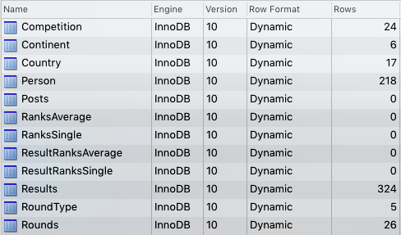
Schema

Slide 4
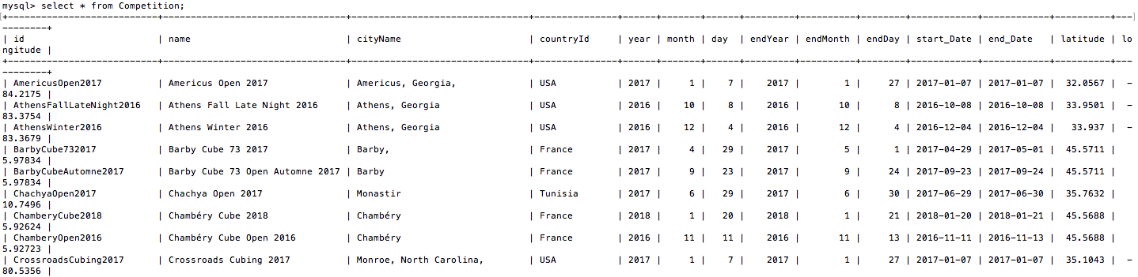
Competition Table

Slide 5
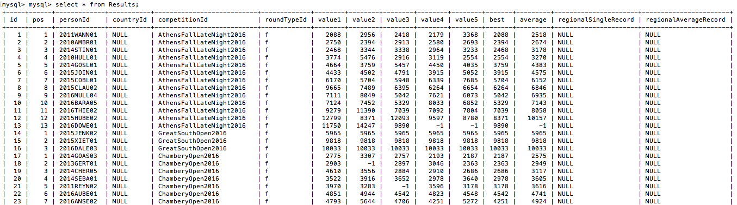
Results Table

Slide 6



Architecture
Client → Cloudflare → Heroku backend (Node.js) → Amazon RDS (MySQL)

Slide 7


APIs
Leaflet.js + Mapbox + our own

Slide 8
Synopsis
On page load, Leaflet requests map tiles from Mapbox & data from our backend
Request goes through Cloudflare, returns cached tiles/data whenever possible.
Hits endpoints at https://kilominx.brandoncanaday.me/api/* and runs SQL queries on Amazon MySQL instance that return the result/competition data.
Frontend Javascript creates markers, popups, data tables, etc. from the data.

Slide 9
Demo

